Slide 1
Analysis of Neighborhood
A new italian restaurant in Pairs

Slide 2
Business Case
We tried to find out
locations that are not already crowded with restaurants.
Areas with no Italian restaurants in vicinity.
Place availables as close to city center as possible

Slide 3
Data
To answer our question we used :
Google Maps API Reverse geocoding
Foursquare API
GOOGLE Maps API geocoding
In order to get geo information and venues informations

Slide 4
Methodology
We have collected the required data: location and type (category) of every restaurant within 6km from Paris center (Place de la République). We have also identified Italian restaurants (according to Foursquare categorization).
We used heatmaps to identify a few promising areas close to center with low number of restaurants in general (and no Italian restaurants in vicinity) and focus our attention on those areas.
We created clusters of locations that meet some basic requirements established in discussion with stakeholders: we took into consideration locations with no more than two restaurants in radius of 250 meters, and we wanted locations without Italian restaurants in radius of 400 meters.
We created clusters (using k-means clustering) of those locations to identify general zones / neighborhoods / addresses which should be a starting point for final 'street level' exploration and search for optimal venue location by stakeholders.

Slide 5
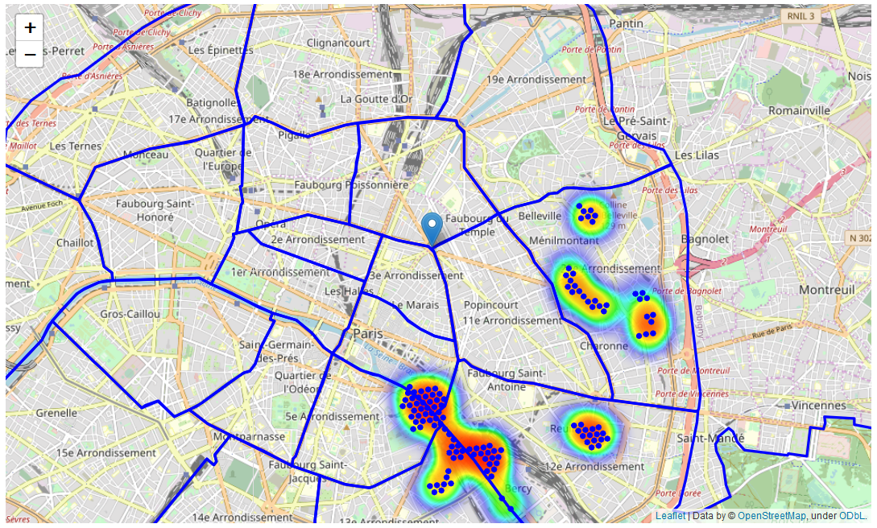
Analysis & Results
Places without high density of italian restaurant

Slide 6
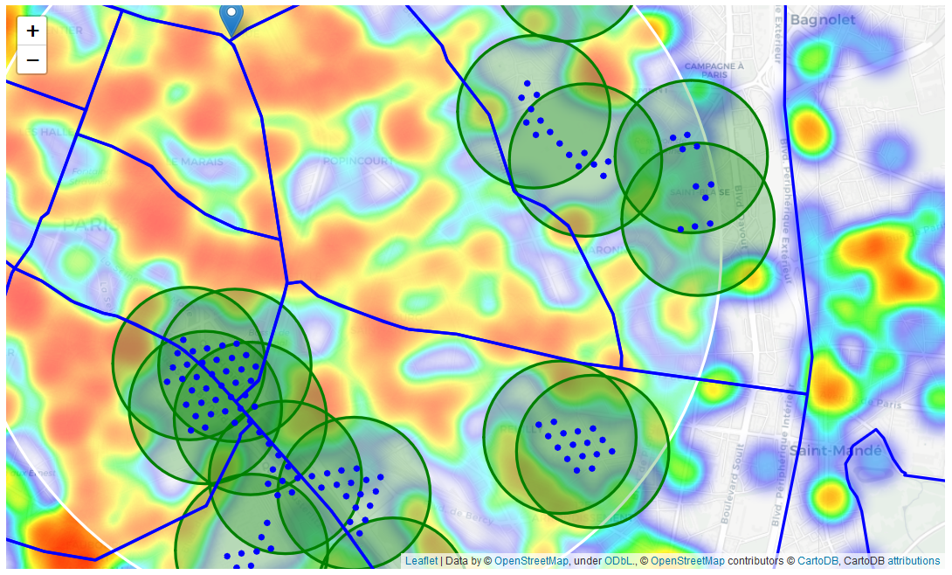
Analysis & Results
Clusters thanks to K-Means

Slide 7
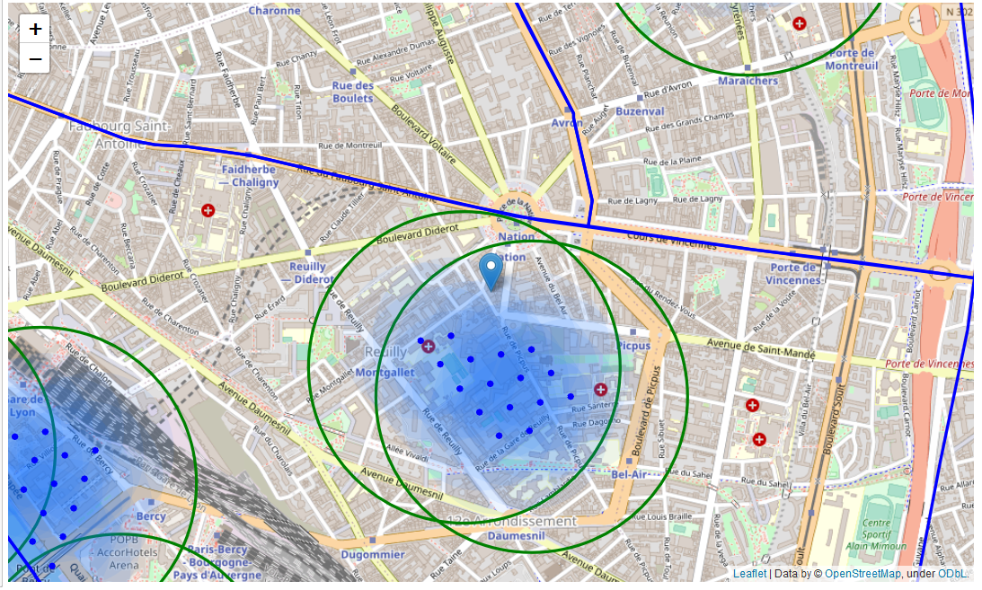
Analysis & Results
Good places in Picpus

Slide 8
Discussion
Result of all this is 15 zones containing largest number of potential new restaurant locations based on number of and distance to existing venues - both restaurants in general and Italian restaurants particularly.
This, of course, does not imply that those zones are actually optimal locations for a new restaurant! Purpose of this analysis was to only provide info on areas close to Paris center but not crowded with existing restaurants (particularly Italian) - it is entirely possible that there is a very good reason for small number of restaurants in any of those areas, reasons which would make them unsuitable for a new restaurant regardless of lack of competition in the area.
Recommended zones should therefore be considered only as a starting point for more detailed analysis which could eventually result in location which has not only no nearby competition but also other factors taken into account and all other relevant conditions met.

Slide 9
Conclusion
Clustering of those locations was then performed in order to create major zones of interest (containing greatest number of potential locations) and addresses of those zone centers were created to be used as starting points for final exploration by stakeholders.
Final decission on optimal restaurant location will be made by stakeholders based on specific characteristics of neighborhoods and locations in every recommended zone, taking into consideration additional factors like attractiveness of each location (proximity to park or water), levels of noise / proximity to major roads, real estate availability, prices, social and economic dynamics of every neighborhood etc.

